Slide 1

DriverPass System Analysis
Michael Farag
Notes:
[No speaker notes required for this slide.]

Slide 2

System Requirements
The system shall provide online
practice exams.
The system shall allow the student to book, modify, and cancel appointments.
The system will offer three different driving packages.
•The system should be web based, accessible on mobile platforms is a plus .
Interactive ability should allow the user to navigate the website with ease to provide a good user experience.
Notes:
[In your speaker notes, include an explanation of the different requirements you determined for DriverPass’s system. What are the functional requirements you selected to describe? What are the nonfunctional requirements you selected to describe? Be sure to explain how these requirements meet DriverPass’s needs.]

Slide 3
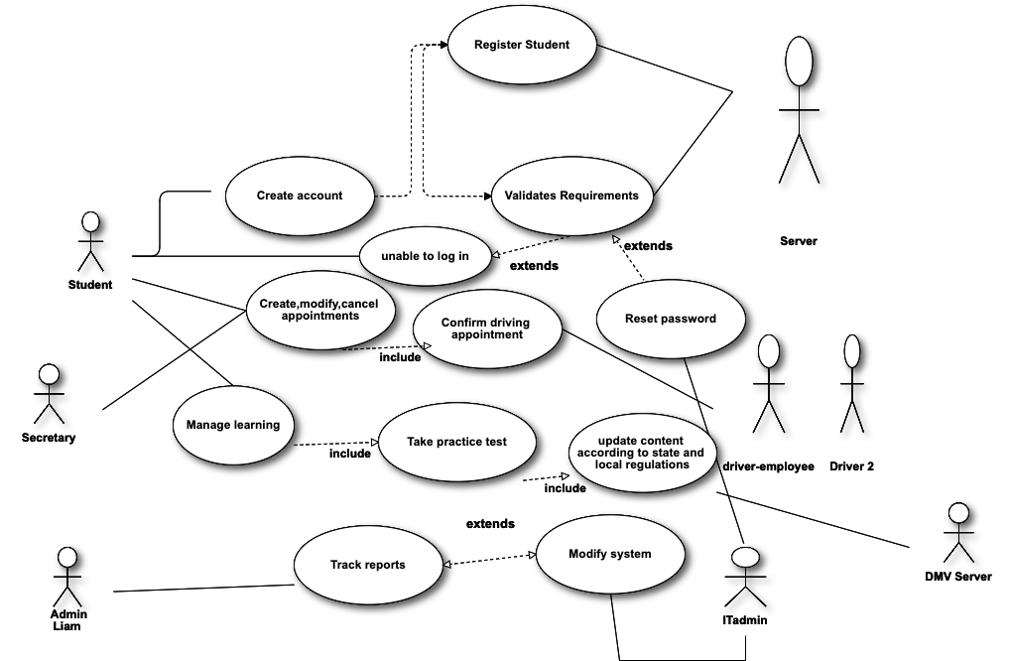
Use Case Diagram
Notes:
There are seven actors interacting in the system. The student is the only actor interacting with the front end of the system. The other actors ( secretary, admins,server,dmv server, driver pass drivers all interact with the system on the back end).

Slide 4
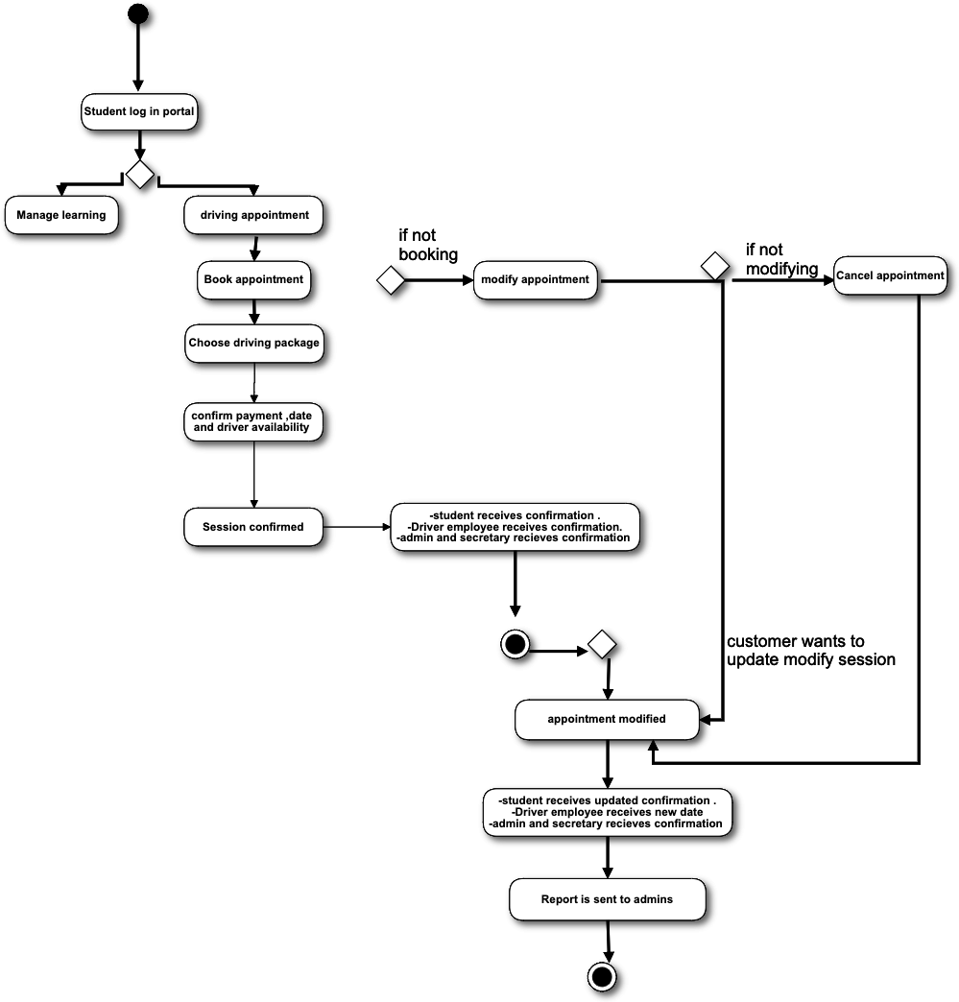
Activity Diagram
Notes:
The second use case “. Driving lessons - appointments”
Some attributes to be mindful of when creating the use case Book driving appointment, cancel driving appointment, cancel driving appointment, confirm availability, confirm driver availability, confirm change, report sent to admin .
The steps to book an appointment are simple. If the user clicks on driving appointments, the user will be prompted to choose the driving package and confirm payment type and availability. A confirmation is sent out to the student. If the student wishes to modify the appointment, the book appointment will have another label “ modify appointment or cancel appointment” . Once any changes to initial confirmation are made, the system will send another confirmation email to the student, and to driver pass driver and admin. To reduce the number of cancelations, a follow up will be made to the customer to win back any canceled appointments. The secretary will call within 24 hours of cancelations .

Slide 5
Security
The system will be encrypted using the top of line technology as it is a very secure way to encrypt login information. Other ways we will implement to protect against brute forces by using two-factor authentication and limiting the number of incorrect login. If another IP address was detected from a student, the system would trigger the two-factor authentication. If the incorrect password was typed in 3 times, the self-serve reset tool would direct the student to reach out to the ITadmin to recover the proper credentials.

Slide 6
System Limitations
The system is a web based, needing internet connectivity to connect to portal.
Hardware limitation on the client’s end , which may impact the user experience. Lack of internet connectivity, or old hardware that makes loading content a hassle, or no audio , which can impact the user experience.
Notes:
[What are the limitations of your design? In your explanation, keep your audience in mind by avoiding the use of technical terms.]

